Slide 1
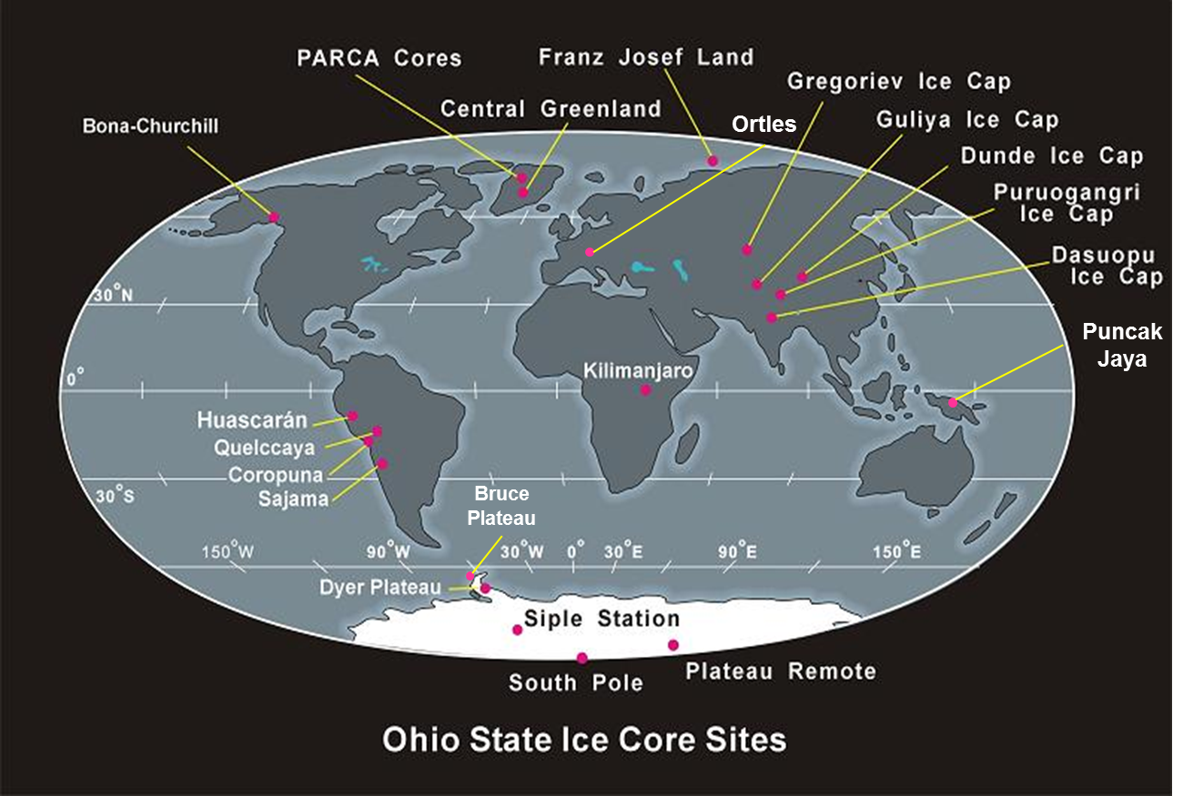
bpcrc.osu.edu

Slide 2
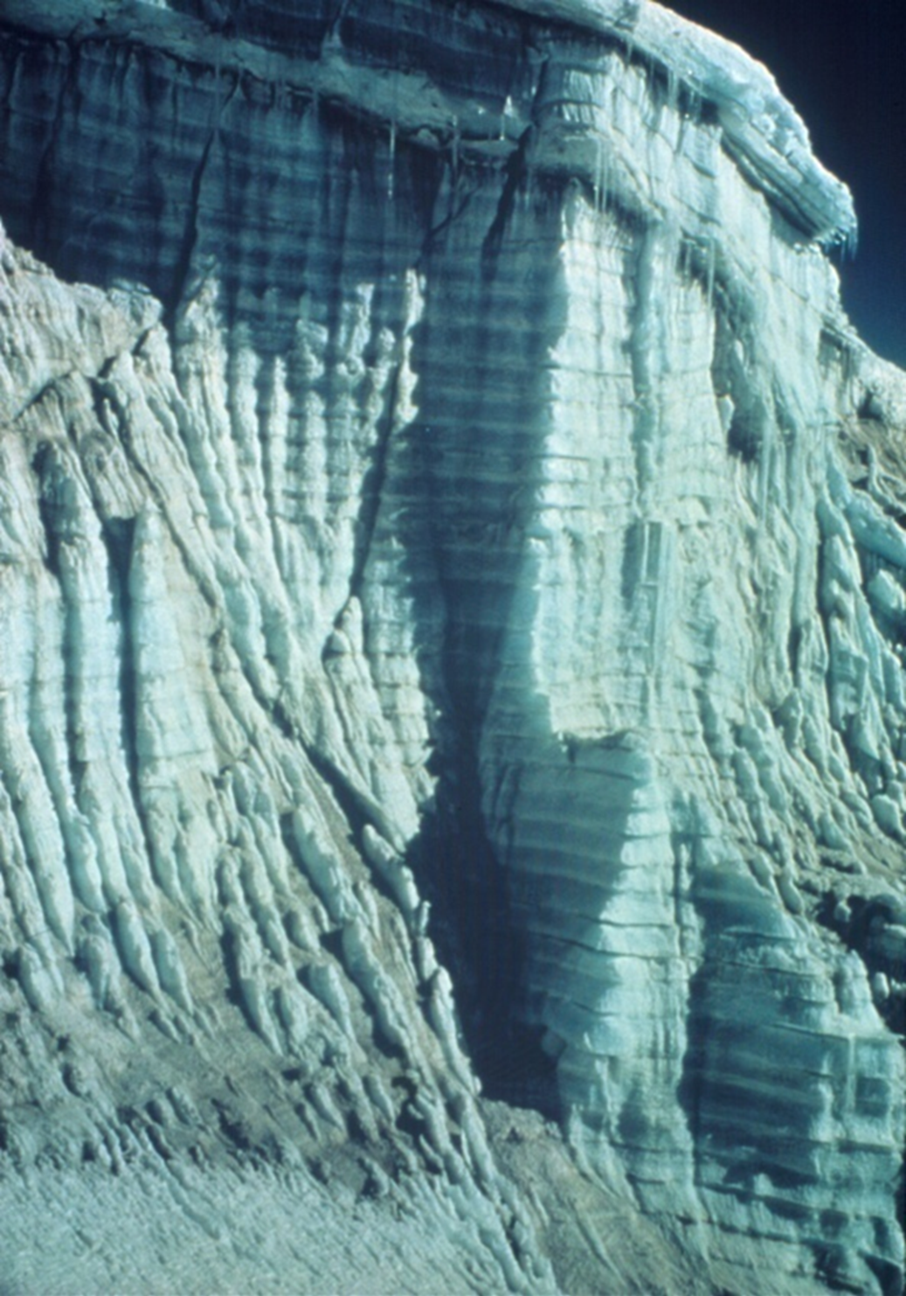
Photo courtesy of Lonnie G. Thompson

Slide 3
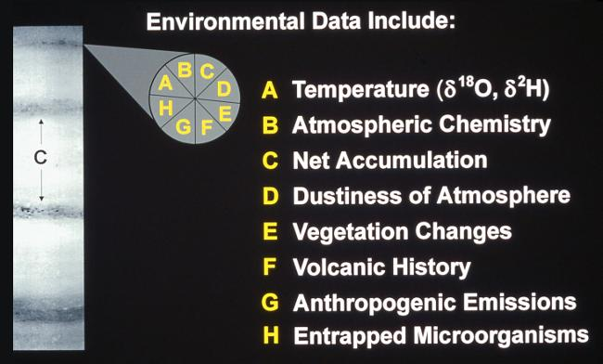

Slide 4
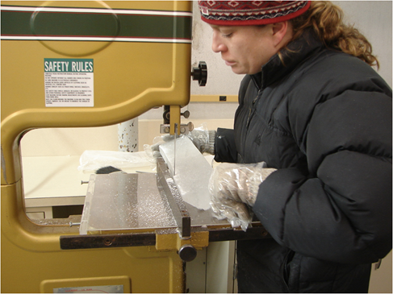
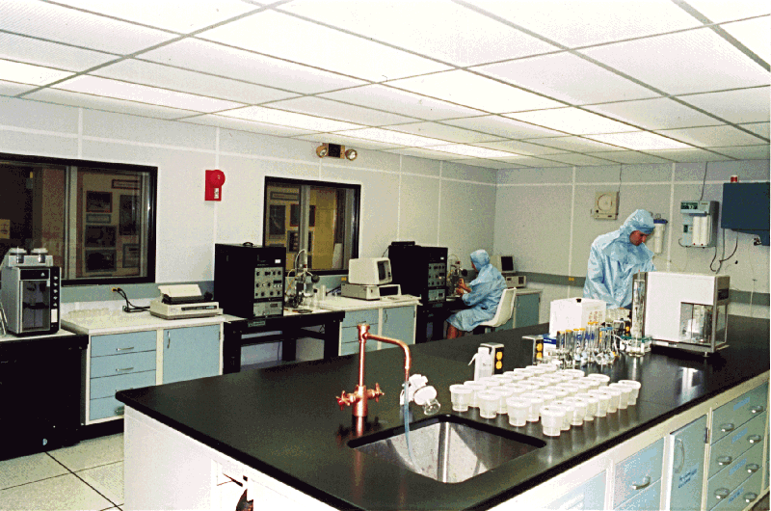
β
Anions and Cations
Dust
δ¹⁸O
bpcrc.osu.edu
Archive
Ice core cross section
bpcrc.osu.edu

Slide 5
Higher temperatures = more energy to evaporate heavy ¹⁸O
¹⁸O (heavier than ¹⁶O) preferentially precipitates
¹⁶O (lighter than ¹⁸O) preferentially evaporates

Slide 6
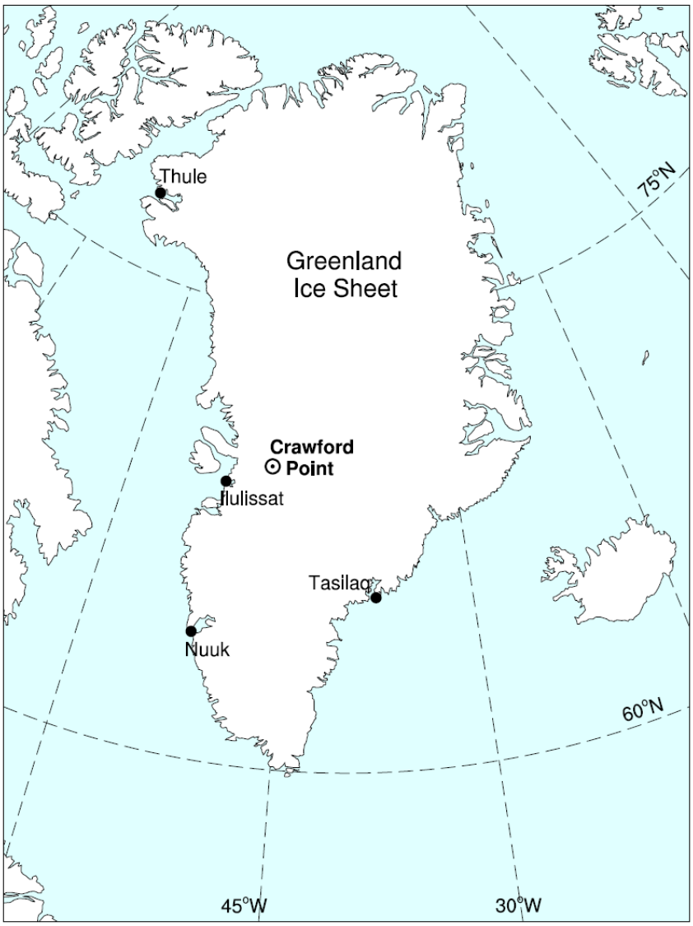
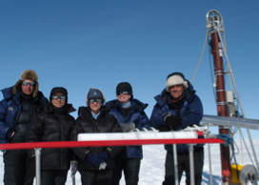
Ice core dating activity
You will be given data from the Crawford Point, Greenland ice core

Slide 7
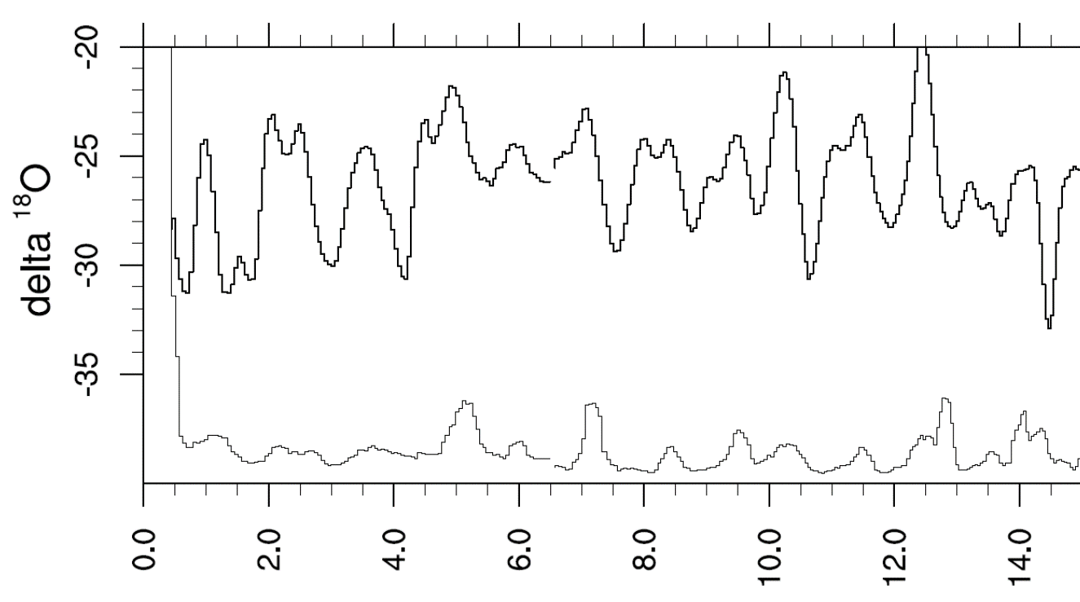
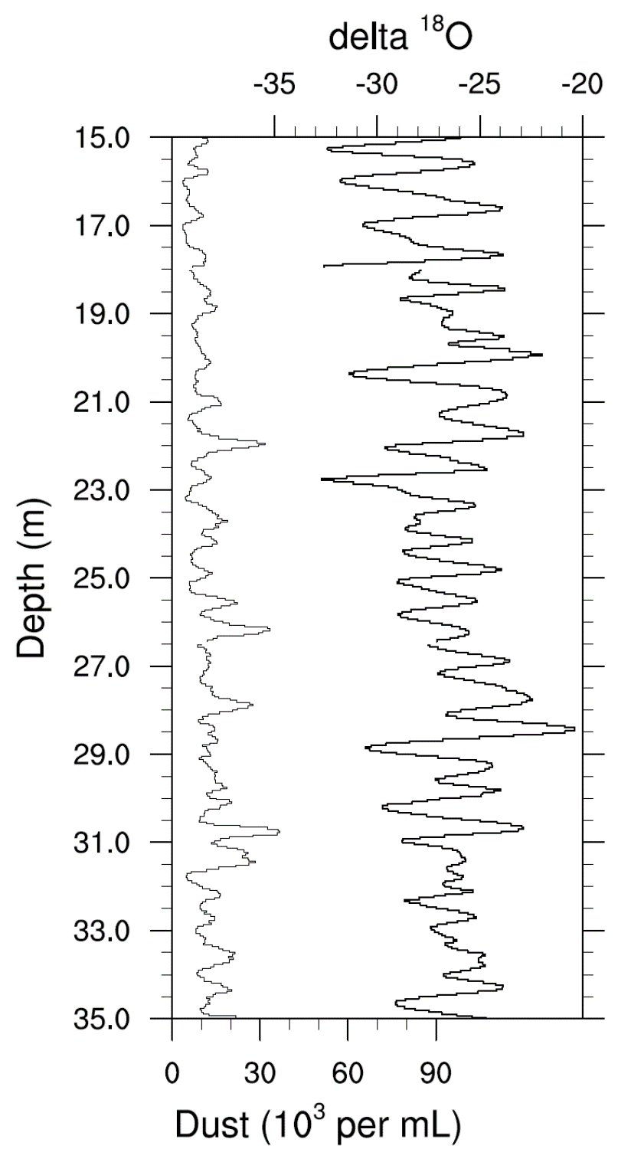
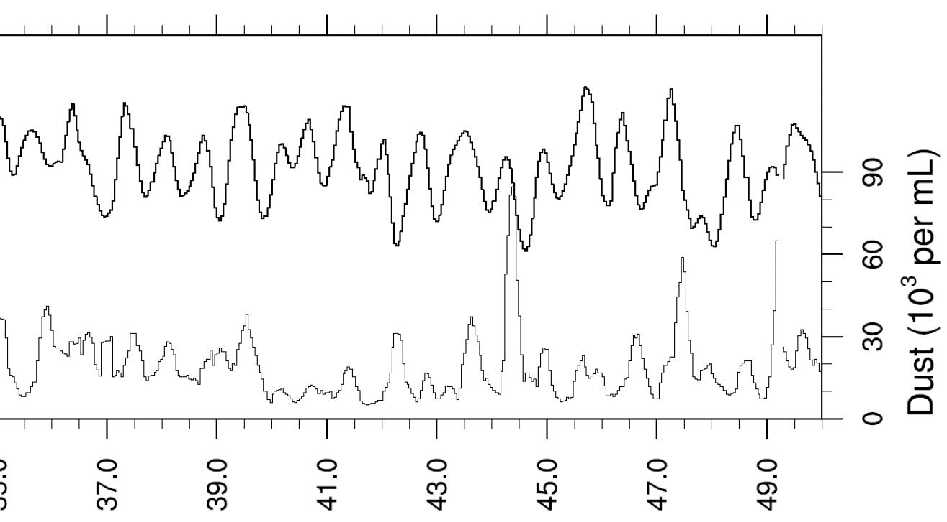
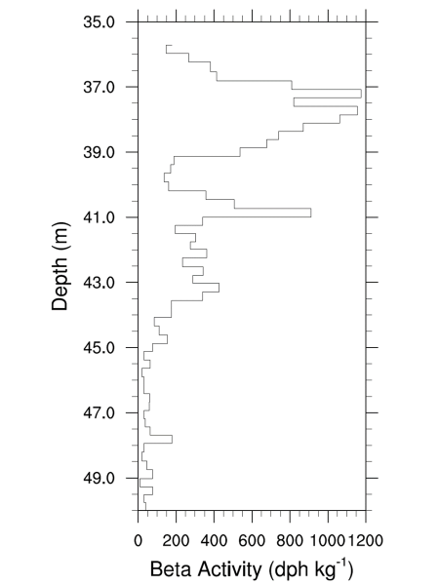
Task 1: Study the data in front of you and list 5 observations about these data.
Consider trends or patterns in the data.
Consider how these proxy data relate to the climate.

Slide 8
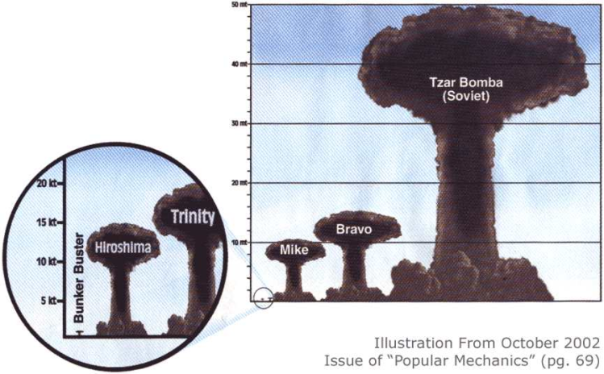

Slide 9
Task 2: Apply the timeline of nuclear bomb testing to the radioactivity data from the ice core.
This will give you the known age of the ice at a certain depth (a reference horizon).
*Important note*
Remember where the oldest ice is located

Slide 10
Task 3: Determine the year in which the ice core was drilled (the year at 0 m).
Given the nuclear reference horizon, devise a strategy to determine the age of ice at the top.
Consider your proxy data and the patterns they display.

